Slide 1
Football Project
Syed Shakir Ali

Slide 2
Consultant Journey
Version Control: GitHub
Scrum Board: Jira
Database Management System: MySQL Server 5.7+ (local or GCP instance)
H2 database and Postman
Back-End: Eclipse(Java)
Front-End: Visual Studio(HTML, JS, CSS)
Unit Testing: Junit
I have learnt about several different technologies throughout my time at QA. The following were required in this project for different reasons.

Slide 3
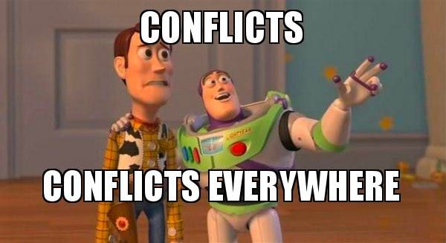
Version Control
Version control – Git
Using the Feature Branch Model
Main -> Dev -> Feature
Push and then merge
Naming feature branches

Slide 4
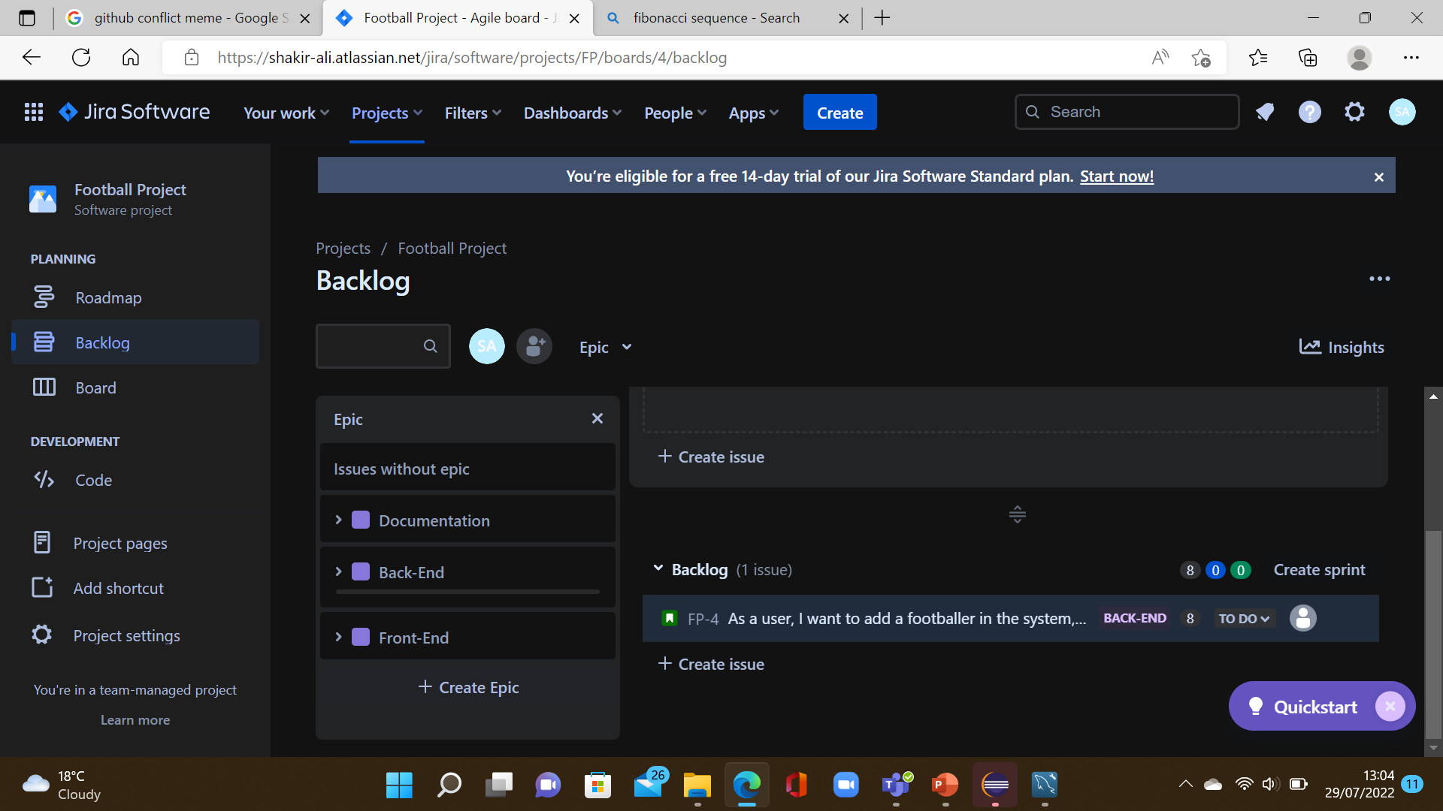
Jira
Scrum Board – Jira
I broke down the project into smaller, manageable tasks and these became my user stories in Jira Scrum Board
User stories were given a story point estimate (based on how labour intensive they would be) and assigned to an epic. Some user stories also had child issues assigned to them
I had 3 epics. Documentation, Back-end and Front-end
Weekly Sprint and Fibonacci

Slide 5
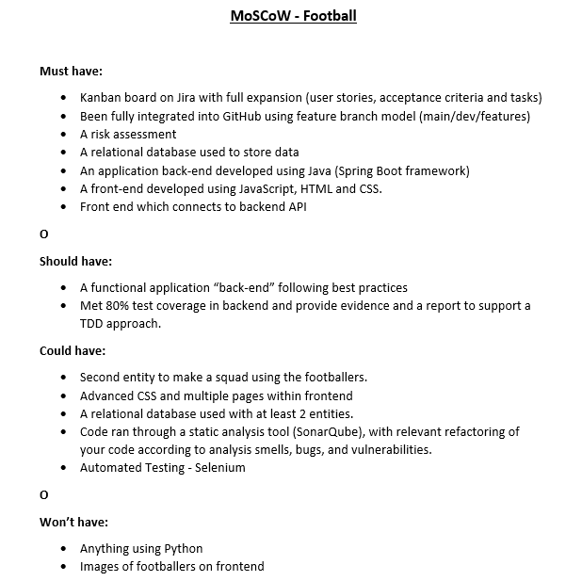
MoSCoW

Slide 6
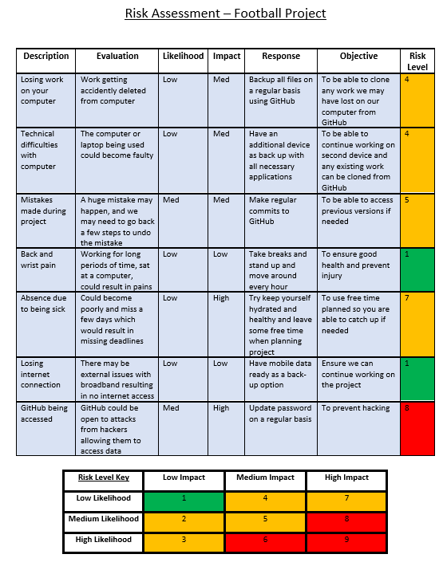
Risk Assessment
Risk Assessment with 7 risks
Created a key to indicate risk level
Key was created using likelihood and impact
Used a colour scheme in key to visually show risk level

Slide 7
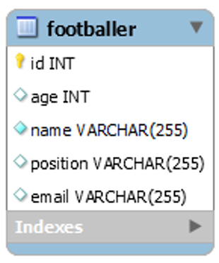
Entity Relationship Diagram
Only one Entity
Could have a teams table to create relationship

Slide 8
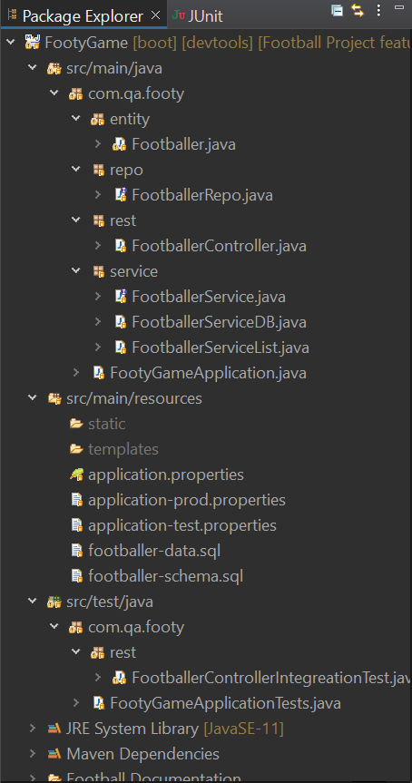
CRUD
CRUD functionality created
They meet the MVP requirements
Fulfil user stories
Tried all function out and they all worked

Slide 9
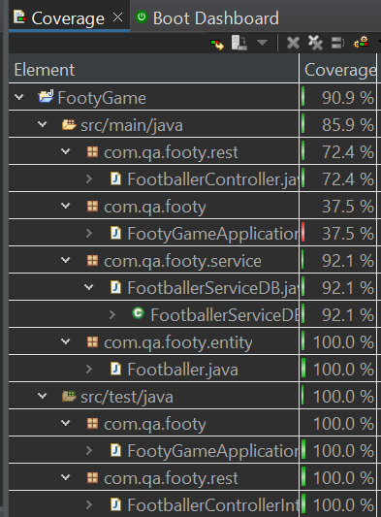
Testing
Completed Testing
85.9%
Use Mockito

Slide 10
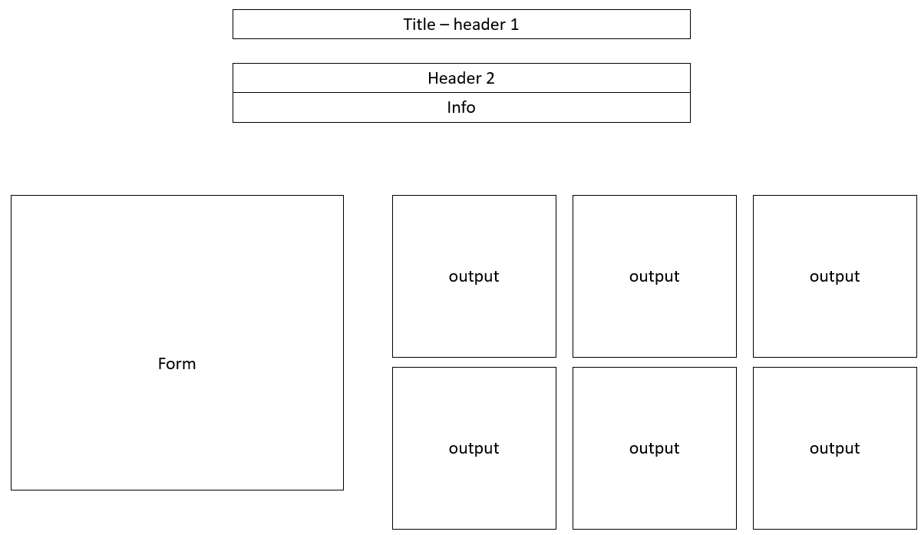
Wireframe

Slide 11
Demo

Slide 12
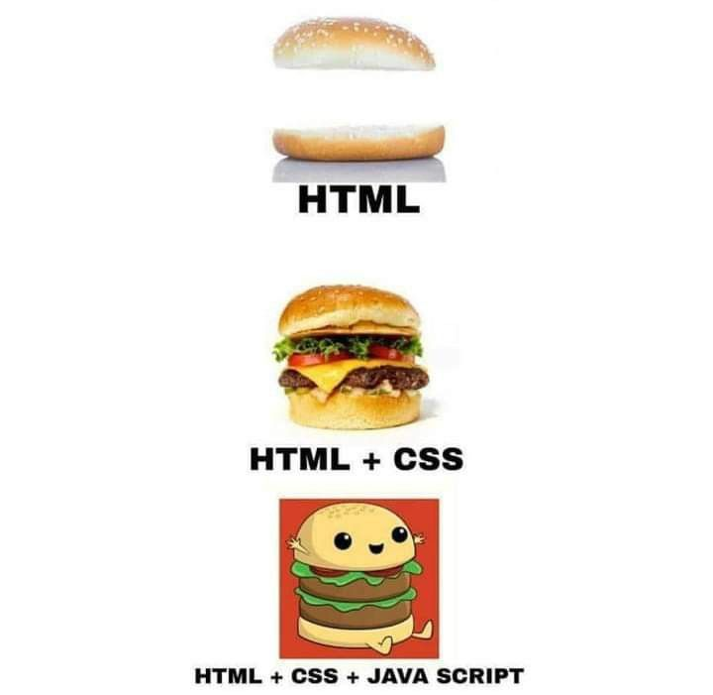
Conclusion
I enjoyed working on the project and it was beneficial in solidifying my knowledge and skills.
Front=End was fun and I want to improve in this area.
SonarQube – Static Analysis
Selenium - Automated Testing

